Slide 1
Discrete Mathematics
Xiaowei Yang
South China University of Technology

Slide 2
Chapter 6. Graphs
Connectivity
Section 8.4

Slide 3
Contents
1
Paths
2
Connectedness
3
Paths and isomorphism

Slide 4
Paths

Slide 5
Paths
A path is a sequence of edges that begins at a vertex of a graph and travels along edges of the graph, always connecting pairs of adjacent vertices.
u1
u2
u3
u4

Slide 6
Definition 1
Let n be a nonnegative integer and G an undirected graph.
A path of length n from u to v in G is sequence of n edges e1,…,en of G
such that f(e1)={x0,x1}, f(e2)={x1,x2}, …, f(en)={xn-1,xn}, where x0=u and xn=v.

Slide 7
Definition 1
When graph is simple, we denote this path by its vertex sequence x0,x1,…,xn.
The list of the vertices uniquely determines the path.
The path is a circuit if it begins and ends at the same vertex, that is, if u=v, and has length greater than zero.

Slide 8
Definition 1
The path of circuit is said to pass through the vertices x1,x2,…, xn-1 or traverse the edges e1,e2,…,en.
A path or circuit is simple if it does not contain the same edge more than once.
A path is denoted as e1,e2,…,en, where f(ei)={xi-1,xi} for i=1,2,…,n, which is not necessary for the multiple edges.
A path of length zero consist of a single vertex.

Slide 9
Example 1
a
b
c
d
e
f
a,d,c,f,e is a simple path of length 4.
d,e,c,a is not a path
b,c,f,e,b is a circuit of length 4.
a,b,e,d,a,b is of length 5 but not simple.

Slide 10
Definition 2
Let n be a nonnegative integer and G an directed multigraph graph.
A path of length n from u to v in G is sequence of n edges e1,…,en of G
such that f(e1)=(x0,x1), f(e2)=(x1,x2), …, f(en)=(xn-1,xn), where x0=u and xn=v.

Slide 11
Definition 2
When there are no multiple edges in the directed graph, this path is denoted by its vertex sequence x0,x1,…,xn.
The path is a circuit or cycle if it begins and ends at the same vertex, that is, if u=v, and has length greater than zero.
A path or a circuit is called simple if it does not contain the same edge more than once.

Slide 12
Definition 2
The terminal vertex of an edge in a path is the initial vertex of the next edges in the path.
When it is not necessary to distinguish between multiple edges, we will denote a path e1,e2,…,en where f(ei)=(xi-1,xi) for i=1,2,…,n by its vertex sequence x1,x2,…,xn.
The notation identifies a path only up to the vertices it passes through.
There may be more than one path that passes through this sequence of vertices.

Slide 13
Example 2
Paths in Acquaintanceship Graphs
There is a chain of six people linking Kamini and Ching.
Eduardo
Jan
Paula
Todd
Kamlesh
Amy
Kamini
Lila
Liz
Steve
Ching
Joel
Gail
Koko
Kari
Shaquira

Slide 14
Many social scientist have conjectured that almost every pair of people in the world are linked by a small chain of people, perhaps contains just 5 or fewer people.
This would mean that almost every pair of vertices in the acquaintanceship graph containing all people in the world is linked by a path of length not exceeding four.
John Guare : Six Degree of Separation

Slide 15
Connectedness

Slide 16
An important question
When is there always a path between two vertices in the graph?
Definition 3: An undirected graph is called connected if there is a path between every pair of distinct vertices of the graph.
Any two computers in the network can communicate if and only if the graph of this network is connected.

Slide 17
Example 5
a
b
a
b
c
c
e
f
d
g
e
d
e
G1 is connected, since every pair of distinct vertices there is a path between them.
G2 is not connected for there is no path in G2 between a and d for instance.

Slide 18
Theorem 1
There is a simple path between every pair of distinct vertices of a connected undirected graph.
Proof: Let u and v be distinct vertices of the connected undirected graph G=<V,E>.
Since G is connected, there is at least one path between u and v.
Let x0,x1,…,xn, where x0=u and xn=v, be the vertex sequence of a path of least length.

Slide 19
Now we will prove that the path of least length is simple.
Suppose it is not simple. Then xi=xj for some i and j with 0≤i<j.
This means that there is a path from u to v of shorter length with vertex sequence x0,x1,…xi-1,xj,…,xn obtained by deleting the edges corresponding to the vertex sequence xi,…,xj-1.

Slide 20
A graph that is not connected is the union of two or more connected subgraphs, each pair of which has no vertex in common.
These disjoint connected subgraphs are called the connected components of the graph.

Slide 21
Example 6
Subgraphs H1, H2 and H3 are the connected components of H.
b
d
e
f
H2
a
c
h
g
H
H3
H1

Slide 22
The removal of a vertex and all edges incident with it produces a subgraph with more connected components than in the original graph.
Such vertices are called cut vertices.
The removal of a cut vertex from a connected graph produces a subgraph that is not connected.
An edge whose removal produces a graph with more connected components than in the original graph is called a cut edge or bridge.

Slide 23
a
d
f
g
b
c
e
h
The cut vertices of G are b, c and e.
The cut edges {a, b} and {c, e}.

Slide 24
Connectedness in Directed Graphs
When is there always a path between two vertices in the directed graph?
Definition 4: An directed graph is strongly connected if there is a path from a to b and from b to a whenever a and b are vertices in the graph.

Slide 25
A directed graph can fail to be strongly connected but still be in “one piece”.
Definition 5 makes this notion precise.
Definition 5: A directed graph is weakly connected if there is a path between every two vertices in the underlying undirected graph.

Slide 26
Strong connected and weakly connected
A directed graph is weakly connected if and only if there is always a path between two vertices when the directions of the edges are disregarded.
Any strongly connected directed graph is also weakly connected.

Slide 27
Example 9
a
b
a
b
c
c
e
G
d
e
H
d
G is strongly connected because there is a path between any two vertices in this directed graph.
Hence, G is also weakly connected.

Slide 28
Example 9
a
b
a
b
a
b
c
c
c
e
d
e
d
G
e
H
d
The graph H is not strongly connected. There is no directed path from a to b in this graph.
However, H is weakly connected, since there is a path between any two vertices in the underlying undirected graph of H.

Slide 29
The subgraphs of a directed graph G that are strongly connected but not contained in larger strongly connected subgraph, that is,
The maximal strongly connected subgraphs, are called the strongly connected components or strong component of G.
a
b
1、Vertex a
2、Vertex b
3、Graph consisting of vertices b, c and d and edges (b, c), (c, d) and (d, b)
a
b
c
c
e
d
e
d

Slide 30
Paths and Isomorphism

Slide 31
There are several ways that paths and circuits can help determine whether two graphs are isomorphic.
For example, the existence of a simple circuit of a particular length is a useful invariant that can be used to show two graphs are not isomorphic.
Paths can be used to construct mappings that may be isomorphic.

Slide 32
As we mentioned, a useful isomorphic invariant for simple graphs is the existence of a simple circuit of length k, where k is a positive integer greater than 2.
Example 12 illustrates how this invariant can be used to show that two graphs are not isomorphic.

Slide 33
Example 12
u1
v1
u6
u2
v6
v2
u5
u3
v5
v3
u4
v4
G
H
Six vertices, and eight edges.
Four vertices of degree three, and two vertices of degree two.
Three invariants - all agree for two graphs.

Slide 34
Example 12
u1
v1
u6
u2
v6
v2
u5
u3
v5
v3
u4
v4
G
H
However, H has a simple circuit of length three, namely, v1,v2,v6,v1
whereas G has no simple circuit of length three, as can be determined by inspection.

Slide 35
Example
We can also use paths to find mappings that are potential isomorphsms.
u1
v1
u1
v5
v2
u2
u5
u4
v4
v3
G
H

Slide 36
Example 13
u2
v1
u1
v5
v2
u3
u5
u4
v4
v3
G
H
5 vertices and 6 edges.
2 vertices of degree 3 and 3 vertices of degree 2
1 simple circuit of length 3, 1 simple circuit of length 4, and simple circuit of length 5.

Slide 37
Example 13
u2
v1
u1
v5
v2
u3
u5
u4
v4
v3
G
H
We follow paths that go through all vertices so that the corresponding vertices in 2 graphs have the same degree.
u1,u4,u3,u2,u5 in G – v3,v2,v1,v5,v4 in H
The paths both go trough every vertex in the graph.

Slide 38
u2
v1
Isomorphic
u1
v5
v2
u3
u5
u4
v4
v3
G
H
u1,u4,u3,u2,u5 in G
v3,v2,v1,v5,v4 in H
Degree: 3 2 3 2 2

Slide 39
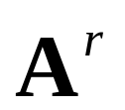
Count paths between vertices
The number of paths between two vertices in a graph can be determined using its adjacency matrix.
Theorem 2: Let G be a graph with adjacency matrix A with respect to the ordering v1,v2,…,vn.
The number of different paths of length r from vi to vj, where r is a positive integer, equals the (i, j)th entry of .

Slide 40
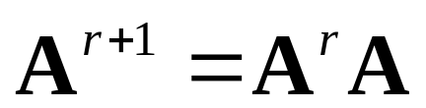
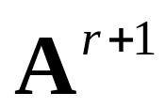
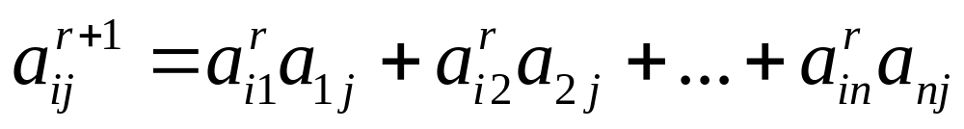
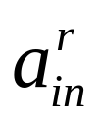


Proof. The number of paths from vi to vj of length 1 is the (i, j)th entry of A, since this entry is the number of edges from vi to vj.
The entry of equals
is the number of the paths of length r from to .

Slide 41
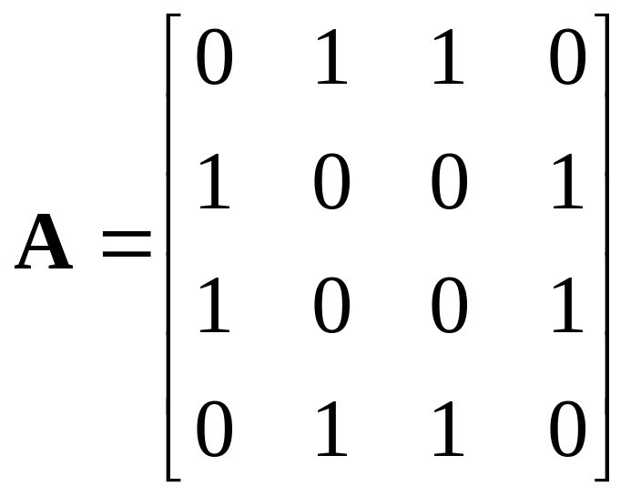
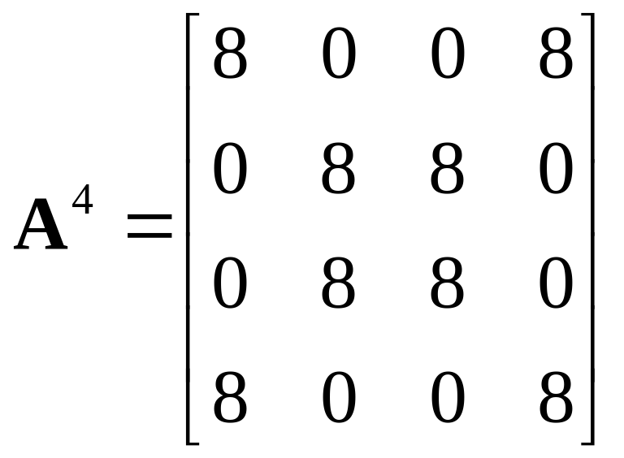
Example 14
a
b
d
c
a,b,a,b,d; a,b,a,c,d;
a,b,d,b,d;a,b,d,c,d;
a,c,a,b,d;a,c,a,c,d;
a,c,d,b,d;a,c,d,c,d;

Slide 42
Applications

Slide 43
Applications
1. 设有a,b,c,d,e,f,g七个人，他们分别会讲的语言如下：a会讲英语；b会讲汉语和英语；c会讲英语、西班牙语和俄语；d会讲日语和汉语；e会讲德语和西班牙语；f会讲法语、日语和俄语；g会讲法语和德语。试问这七个人中，是否任意两个都能交谈（必要时可借助其他人的翻译）

Slide 44

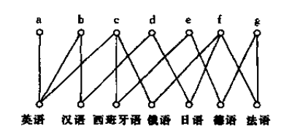
Applications

Slide 45
Applications
2.求下图G最大的强连通分支和最大弱连通分支
V1
V2
V5
V6
V3
V4
V7
V8

Slide 46
Applications
解：由结点集合｛v1,v2,v3,v4｝所导出的子图为该图的最大强连通分支，图G自身就是该图最大弱连通分支。
V1
V2
V5
V6
V3
V4
V7
V8

Slide 47
End of Section 6.4
Click to edit company slogan .

